Slide 1
Microfacies lecture - 5

Slide 2
Headline Of Microfacies Course
1- preface
2-

Slide 3
Diagenessis Procces

Slide 4
Headline Of Microfacies Course
1- preface
2-

Slide 5
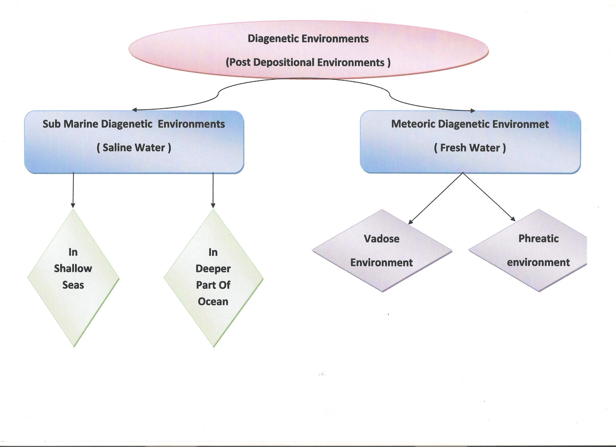

Slide 6
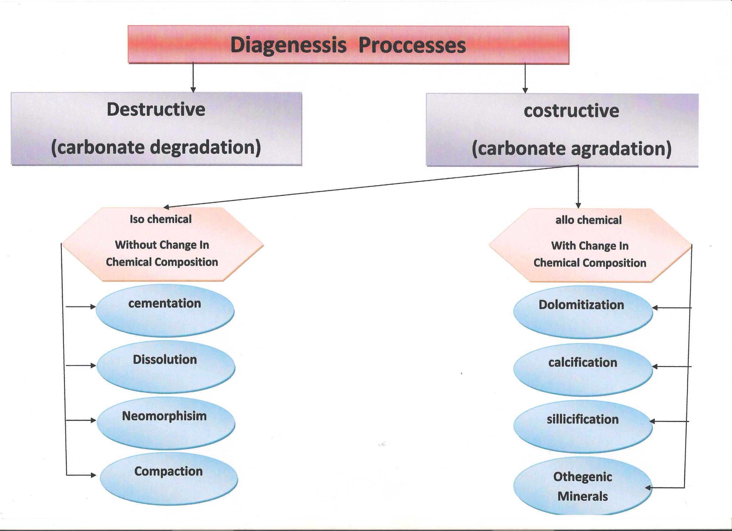

Slide 9
Questions

